Slide 1
The College Application Process Mr. Walter Sandstrom (A-Lo) wsandstrom@cbsd.org Mrs. Melanie Jones (Lp-Z) mejones@cbsd.org
This Photo by Unknown author is licensed under CC BY-SA.

Slide 2
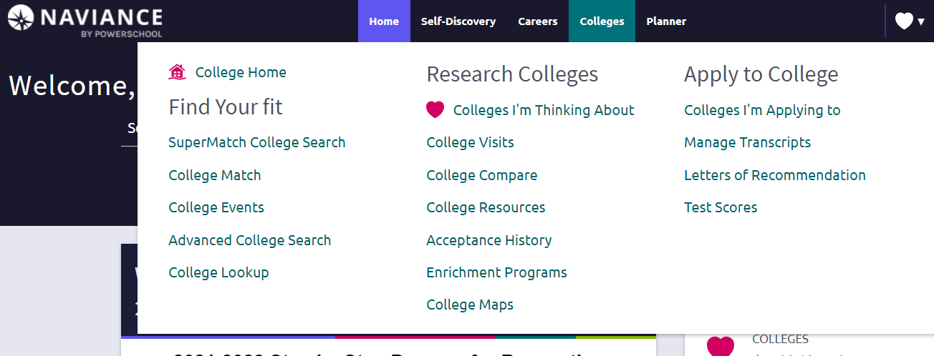
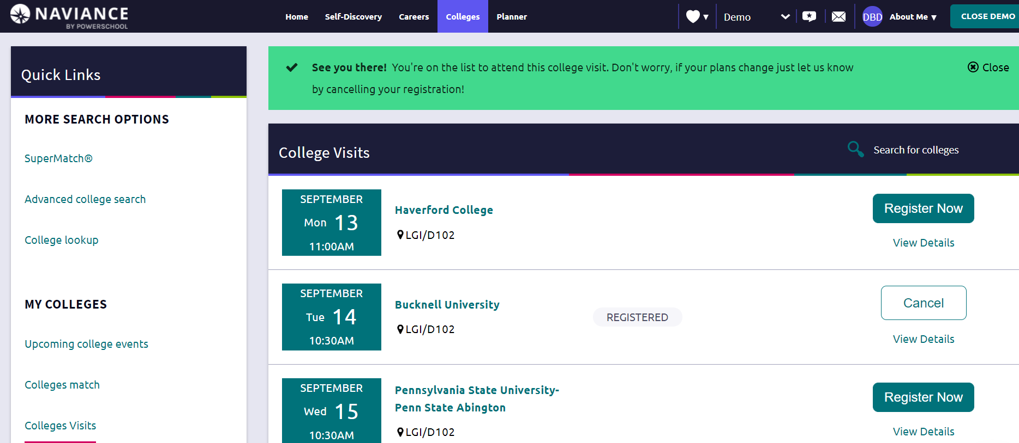
How to Sign-up for College Admissions Visits to CB East

Slide 3
CB East College Application Site
Step-by-step instructions
(right hand side of page)

Slide 4
College Application Deadlines
Rolling
Apply early because colleges make their decisions as applications come in (typically by October 15th to maximize chances)
Once the class is full they will stop taking applications
Early Action (EA) November
Non-binding. Can apply to multiple colleges through EA.
Single-Choice Early Action: Non-binding, Communicates high interest, but only can apply to one college and nothing through ED
Early Decision (ED 1 and ED2) November & January
Binding, usually notified of decision by winter break
Only can apply to one school ED
May increase chance for admission.
Must sign an ED agreement: parent, student and counselor
Regular January - March
Apply by deadline set and usually find out in March/April
May increase chance for admission.

Slide 5
Deadlines for popular schools
Temple University
November 1st – Early Action
Penn State University
Modified Rolling Admissions
November 1st – Early Action, we recommend applying EA to Penn State
University of Pittsburgh
Rolling Admission (we advise by Oct. 15th) but if you want to be considered for scholarships you must apply by December 1st
PA State Universities (14 in total)
Ex: West Chester, Bloomsburg, Indiana University of PA
Home | PA State System of Higher Education
Rolling Admission (we advise Oct. 15th)
System Redesign: Northeast and West Plans
System Redesign | PA State System of Higher Education

Slide 6
Step-by-Step Instructions
Step 1: Release of Records
Step 2: Complete College Applications
Step 3: Requesting Transcripts
Step 4: Requesting Letters of Recommendation
Step 5: Submitting Test Scores
Click here for the Step by Step Instructions Guide

Slide 7
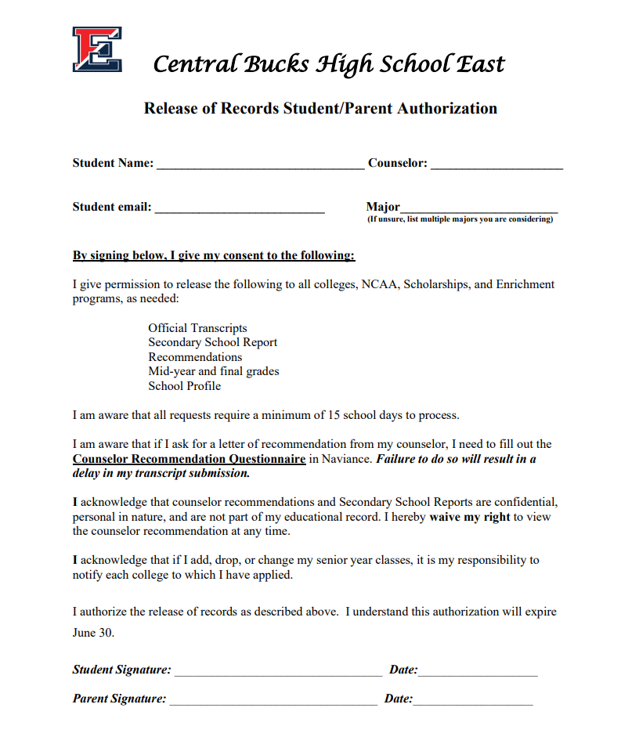
Step 1: Release of Records
This form must be completed for us to send your transcripts, recommendations, or other school records to colleges, scholarships, military, NCAA, etc.
Sign and return this form to Ms. Kozman at ckozman@cbsd.org or drop it off in C106 (school counseling office).

Slide 8
Step 2: Complete College Applications
The Common Application
Over 1,000 colleges accept it
https://www.commonapp.org/
The Coalition for College Application
150+ colleges accept it; open now
http://www.coalitionforcollegeaccess.org/
Some colleges create their own application
College Specific Applications

Slide 9
Matching Common App & FERPA Waiver
Create Common App account Please watch the video for instructions on how to match your Common App with Naviance!
Add colleges to Common App account
Add colleges into Naviance via “colleges I’m applying to”
Click on pink box: Match Accounts
Input your Common App email address
Always remember common app password
Waive your rights on FERPA waiver
Common App Account Matching Video

Slide 10
Step 3: Requesting Transcripts
You cannot request a Transcript through Naviance until you have:
Submitted your signed Release of Records form (Step 1); and
If using Common App: Created account; completed most sections; Matched with Naviance, and submitted FERPA waiver (Step 2). If you have completed these steps, then proceed.
Please remember to provide us with a minimum of 15 school days notice prior to your college deadline.
Videos to assist with steps below:
Add Colleges I'm Applying To in Naviance
Requesting Transcripts in Naviance

Slide 11
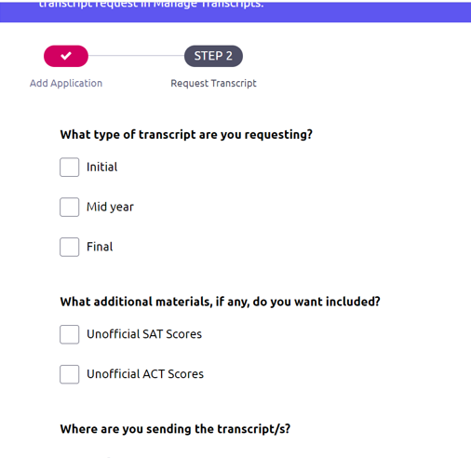
Step 3: Requesting Transcripts
Do not check either box. We will not send ANY
of your testing (official or unofficial) to colleges.

Slide 12
What is Sent When a Transcript is Requested
Transcript
Senior Schedule
School Profile
Secondary School Report
Counselor Recommendation (if applicable)
Please Note: We do not send ACT/SAT/AP scores

Slide 13
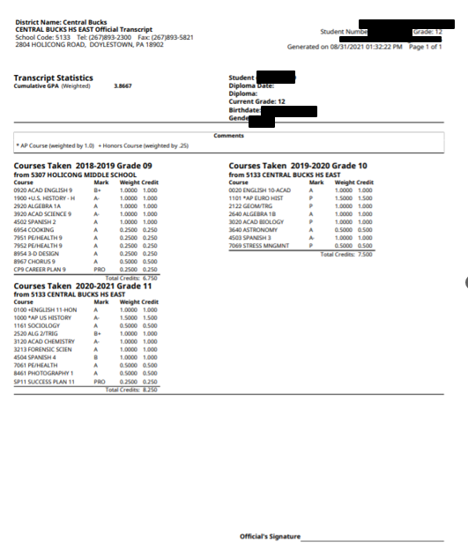
Example of a
Student Transcript
Shows all courses and final course grades from grades 9 through 11
The weighted Cumulative GPA is listed on the top left corner

Slide 14
Example of a Senior Year Schedule
Shows all courses for grade 12

Slide 15
School Profile
This is updated annually, and it informs colleges of our credit requirements, Honors, AP offerings, as well as our grading scale.
It includes an explanation of the COVID-19 related grading changes.
This document helps colleges evaluate a student in the context of what is available at East.

Slide 16
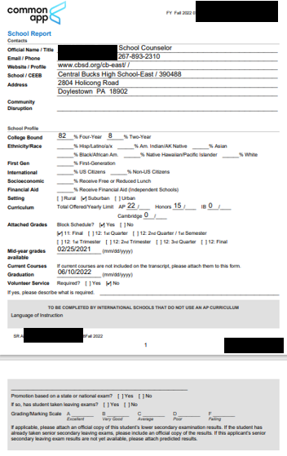
Secondary School Report (SSR)
This is a standard form that provides colleges with information they need to know about East and the applicant.
We have access to the SSR Common App form
If you’re applying to a college NOT through Common App, we will create a SSR for you!
There is no need to provide us with the SSR specific to your school.

Slide 17
Self-Reporting Academic Record (SRAR)
Some colleges ask students to self-report courses and grades
Examples: Penn State, Univ. of Pittsburgh, Univ of DE, Rutgers, etc.
Unofficial transcripts can be obtained through the student portal.
Complete the SRAR for these schools in addition to the application for admission:
Self-Reported Academic Record | Scarlet Computing Solutions (scarletcs.com) (selfreportedtranscript.com)
Even if you are self-report your grades through SRAR, the name of the school must be added to the “colleges I’m applying to” list in Naviance. This helps us to track your application.
However, since you are self-reporting, you do not need to check the “Initial” transcript box in Naviance to request a transcript.

Slide 18
Step 4: Requesting Letters of Recommendation
After you click the link below and the video starts you will then need to click:
Request LOR- Specific College
Do Not click on Request LOR - General
Student LOR Updates 6-15-21 (screencast.com)

Slide 19
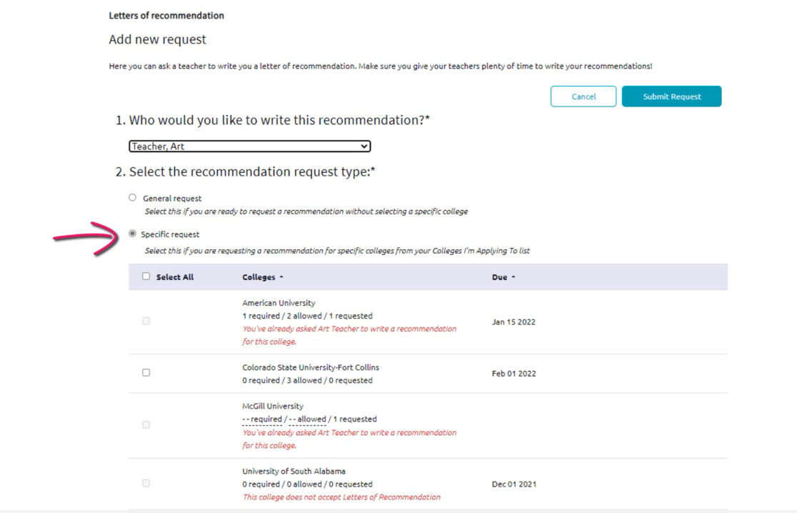

Slide 21
Counselor Letters of Recommendation

Slide 22
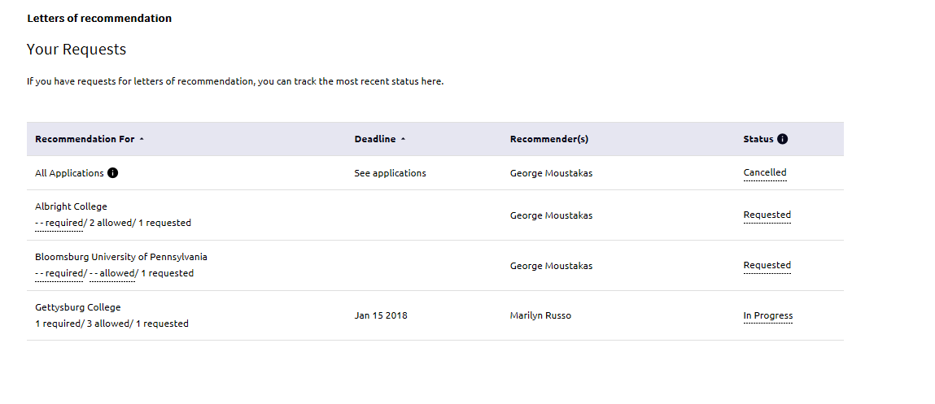
If you see a cancelled status that means that the teacher or the counselor did not accept your request
If it was the counselor, you most likely did not complete your College Recommendation Questionnaire in Naviance
If you see canceled, you should personally talk to the individual to correct any missing info

Slide 23
Step 5: Submitting Test Scores (if applicable)
Make requests for your SAT/ACT scores to be sent directly from the testing agency to the college www.collegeboard.com and/or www.act.org
No test scores will be included on the transcript or with your documents CB East sends.
Visit College Board and ACT websites for processing time frames.

Slide 24
After you submit your application… 1st MP GRADES
Some colleges may request 1st MP before making an admissions decision.
Please contact Mrs. Kozman at ckozman@cbsd.org or in C106 if a college requests 1st mp grades.
1st MP grades should be sent only if the college requests it. Sending information to colleges they do not want. Often this will slow the application review process and does not help admissions chances. Remember: Always follow the college’s specific admissions instructions.

Slide 25
Funding your education
Financial Aid Overview (Virtual Event) on Tuesday, October 4th at 6:30 pm
FAFSA Overview (Virtual Event) on Wednesday, November 16th at 6:30 pm
The 2023-2024 FAFSA will be available on 10/1/22; www.fafsa.gov 2021 tax information
CSS Profile, if required, completed in the fall
Net Price Calculators on every college website
Start thinking about scholarship search
Naviance, employers, service organizations
You should NOT pay for a scholarship search or opportunity

Slide 26
Financial Aid Programs
Tuesday, October 4th, 6:30 PM
The VIRTUAL District Financial Aid Night, "Financial Aid Overview" will be on Tuesday, October 4, 2022, at 6:30 pm, by our PHEAA representative, Fran McKeown. A link will be provided to log into this session.
Wednesday, November 16th, 6:30 PM
The VIRTUAL "FAFSA Overview” session will be on Wednesday, November 16, 2022, at 6:30 pm, by our PHEAA representative Fran McKeown. A link will be provided to log into this session.

Slide 27
Scholarship websites
NAVIANCE Scholarship List
www.Fastweb.com
www.Scholarships.com
www.Niche.com
www.Collegeboard.com/bigfuture
www.Cappex.com
www.chegg.com/scholarships#

Slide 28
We are here to help you!
Mrs. Kozman– ckozman@cbsd.org; 267-893-2313
School Counseling Assistant and a great resource!
Mr. Walt Sandstrom (A-Lo)
wsandstrom@cbsd.org
Mrs. Melanie Jones (Lp-Z)
mejones@cbsd.org

